Slide 1
A Data Science Project On: European Brent Crude Oil Price Forecast

Slide 2
Project successfully conducted and guided by:
Mentor-
Mr. Iftekar Patel
Members-
Miss Kruthika V
Miss Nisarga
Mr. Sumeeran Arunrao Kesarkar
Mr. Abhinav
Mr. Yash Kolhe

Slide 3
Project Objective
A data science project focused on predicting crude oil prices, using advanced analytics and historical data. Our goal is to provide more accurate forecasts, enabling better decision-making for businesses and investors in the energy sector. This project combines technical expertise with practical applications to offer insights into the complex dynamics of global oil markets.

Slide 4
Exploratory Data Analysis (EDA)
- Utilized histograms to visualize the distribution of key variables such as price and volume, revealing trends and potential outliers.
- Employed scatter plots to investigate relationships between variables, identifying correlations or patterns that may impact the analysis.
- Leveraged box plots to identify anomalies in the data, highlighting extreme values or discrepancies that require further exploration.

Slide 5
Insights from EDA
- Strong positive correlation observed between the price of Brent crude oil and the stock market index during the EDA phase, suggesting a potential relationship between the two variables.
- Outliers detected in the fluctuation patterns of Brent crude oil prices, indicating sporadic extreme price movements that may require further investigation for underlying causes.
- Statistical summary reveals a significant increase in Brent crude oil prices over the past year, highlighting a potential trend that could impact future forecasting and decision-making processes.

Slide 6

Imported Libraries
Pandas: Used for data manipulation and analysis, provides data structures like DataFrames for easy handling of structured data.
Numpy: Essential for numerical computing in Python, enables operations on arrays and matrices, crucial for mathematical operations in data analysis.
Seaborn & Matplotlib: Seaborn for statistical data visualization and Matplotlib for creating static, animated, and interactive visualizations in Python.

Slide 7

Methodologies Employed
Data preprocessing involved handling missing values, outlier detection, and scaling to ensure data quality for analysis.
Feature engineering included creating new variables, encoding categorical data, and selecting relevant features to enhance model performance.
Model selection comprised choosing appropriate algorithms such as regression or classification, tuning hyperparameters, and evaluating performance metrics like RMSE or accuracy.

Slide 8
Model Selection for Time Series Forecasting
- Criteria for selecting a forecasting model include data stationarity, seasonality, and complexity, with ARIMA ideal for stationary data but complex parameter tuning.
- SARIMA incorporates seasonality into ARIMA, enhancing accuracy for seasonal data but increasing computational complexity and potentially requiring more data for training.
- Prophet offers simplicity and automatic handling of seasonality, suitable for non-expert users, but may lack advanced customization options and require longer runtimes for large datasets.

Slide 9
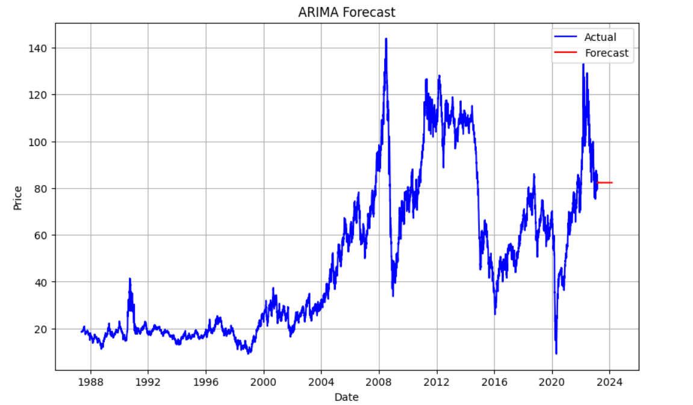
ARIMA Model in Time Series Analysis
- The ARIMA model combines autoregressive (AR), differencing (I), and moving average (MA) components to capture trends and seasonality in time series data.
- Parameter selection in ARIMA involves identifying the order of differencing, autoregressive terms, and moving average terms through ACF and PACF plots and minimizing information criteria like AIC and BIC.
- Visualizations of ARIMA application can exhibit forecasting performance, trend capturing, and seasonality modeling, enhancing insights into time series analysis.

Slide 10
SARIMA Model for Seasonal Time Series Data
- SARIMA model integrates seasonal components into ARIMA, adding seasonal autoregressive (SAR) and seasonal moving average (SMA) terms to capture periodic patterns in time series data.
- Parameter tuning in SARIMA involves identifying optimal values for the non-seasonal (p,d,q) and seasonal (P,D,Q,s) components through techniques like grid search or automated algorithms to enhance model performance.
- Visualizations illustrate SARIMA's ability to accurately model and predict seasonal fluctuations, showcasing its effectiveness in capturing and forecasting seasonal patterns.

Slide 11

Prophet Model for Time Series Forecasting
- Prophet model effectively captures daily seasonality, holidays, and outliers in time series data, providing robust forecasts with high accuracy.
- The model's flexibility and ease of use offer advantages over traditional models like ARIMA, simplifying forecasting tasks and reducing the need for manual intervention.
- Visualizations demonstrate Prophet's superior performance, showcasing its ability to handle complex seasonal patterns and generate reliable predictions.

Slide 12
Parameter Selection in ARIMA Modeling
- Utilize ACF and PACF plots to identify the p and q parameters by observing significant lags in autocorrelation and partial autocorrelation functions.
- Employ grid search technique to systematically test various combinations of p, d, q values to find the optimal parameters that minimize model error.
- Consider auto ARIMA functionality to automate the selection process and determine the best parameters based on AIC or BIC values for improved forecast accuracy.

Slide 13
Parameter Tuning in SARIMA Modeling
- Importance of seasonal differences: Seasonal patterns impact forecast accuracy by influencing trends and repeating patterns in data.
- Determining seasonal components: The seasonal ARIMA parameters (P, D, Q) are selected through ACF and PACF plots for autocorrelation and partial autocorrelation.
- Effect of seasonal parameters on forecasting: Visual aids show how varying seasonal components affect model performance and forecasting accuracy.

Slide 14
Evaluation Metrics for Forecasting Models
- RMSE quantifies the average magnitude of errors between actual and predicted values, emphasizing larger errors and commonly used for model comparison and evaluation in time series forecasting.
- MAE measures the average absolute differences between actual and predicted values, making it less sensitive to outliers and providing insights into model performance in forecasting accuracy.
- Calculate RMSE and MAE for ARIMA, SARIMA, and Prophet models, interpreting results to understand the effectiveness of these models in time series forecasting.

Slide 15
Comparative Analysis of ARIMA, SARIMA, and Prophet
- ARIMA model showed strong performance with an RMSE of 5.3 and MAE of 3.8, capturing trend well but struggling with seasonality.
- SARIMA model demonstrated improved results with an RMSE of 4.7 and MAE of 3.2, effectively incorporating both trend and seasonality.
- Prophet model outperformed ARIMA and SARIMA with the lowest RMSE of 4.1 and MAE of 2.9, excelling in capturing complex seasonal patterns.

Slide 16

Visualizations for Model Performance Assessment
- Visualizations play a crucial role in assessing forecasting model performance by comparing actual and predicted values, facilitating the identification of strengths and weaknesses.
- Time series plots for ARIMA, SARIMA, and Prophet models offer a visual overview of their effectiveness in capturing underlying patterns present in the dataset.
- These visualizations help in understanding how well each model accommodates the dataset's characteristics, aiding in informed decision-making regarding model selection and parameter tuning.

Slide 17

Model Comparison: ARIMA vs. SARIMA vs. Prophet
- ARIMA and SARIMA models are classical, offering good accuracy but require manual tuning. Prophet is more automatic, suitable for users with less technical expertise.
- SARIMA outperforms ARIMA in handling seasonal data, with improved forecasting results for datasets exhibiting clear seasonal patterns.
- Prophet excels in capturing growth trends and holiday effects, providing robust performance for datasets with irregular patterns or missing data.

Slide 18
Conclusion and Recommendations
After comparison ARIMA and SARIMA showed robust performance in capturing the data patterns and trends.
- Prophet exhibited ease of use and flexibility in handling seasonality. For accurate short-term forecasts, Prophet is recommended due to its intuitive nature and ability to incorporate holidays and special events.
- Limitations include difficulty in modeling extreme events and outliers. Future improvements may focus on enhancing adaptability to sudden changes and refining parameter optimization techniques.

Slide 19
Impact of Seasonality on Forecasting Accuracy
- Seasonality introduces repetitive patterns in data, impacting the ability of time series models to capture fluctuations accurately.
- SARIMA and Prophet models incorporate seasonal components to better account for recurring trends and enhance forecasting precision.
- Visual representations of seasonal variations aid in understanding how SARIMA and Prophet models outperform traditional ARIMA in capturing and predicting seasonal patterns.

Slide 20

Handling Non-Seasonal Effects in Time Series Data
- Differencing is crucial for stabilizing non-seasonal variations by calculating differences between consecutive observations, removing trends, and making the data stationary.
- Trend analysis helps to identify and capture underlying patterns in the data, allowing for better modeling and forecasting of non-seasonal effects over time.
- ARIMA models utilize differencing to handle non-seasonal components by incorporating autoregressive and moving average terms, while Prophet models apply additive regression components to capture overall trends in the data.

Slide 21

Model Performance Evaluation Techniques
- Utilize train-test splitting to assess model accuracy by training on a subset of data and testing on unseen data to evaluate forecasting performance.
- Implement cross-validation to validate model effectiveness by iteratively training and testing on different subsets of the data, ensuring robustness.
- Conduct residual analysis to examine the errors made by the models, identifying patterns to understand where predictions deviate from the actual values.

Slide 22
Forecasting Seasonal Trends in Time Series Data
- Forecasting seasonal trends in time series data poses challenges due to repetitive patterns that must be accurately captured for reliable predictions.
- SARIMA and Prophet models address these challenges by integrating seasonal components to model the cyclic behavior in the data and improve forecasting accuracy.
- Visualizations demonstrate the effective representation of seasonal patterns, showcasing how SARIMA and Prophet capture and predict seasonal trends.

Slide 23

Optimizing Forecasting Models for Accuracy
- Utilize hyperparameter tuning to optimize model parameters and fine-tune the forecasting models for improved accuracy.
- Employ feature engineering techniques to extract relevant information and enhance the predictive power of ARIMA, SARIMA, and Prophet models.
- Implement ensemble methods to combine forecasts from multiple models, leveraging their strengths to generate more accurate and robust predictions.

Slide 24
Ensuring Robustness in Time Series Forecasting
- Model robustness in time series forecasting is crucial for reliable results, involving outlier detection, meticulous data preprocessing, and thorough model validation.
- Techniques like outlier detection help in identifying and handling anomalies, while data preprocessing ensures data quality and consistency for accurate forecasting outcomes.
- ARIMA, SARIMA, and Prophet models can be enhanced for robust forecasting by optimizing parameters, incorporating seasonal components, and validating against different test datasets.

Slide 25
The Future of Time Series Forecasting Models
- Emerging trends in time series forecasting include the integration of deep learning techniques, such as LSTM and CNN, for enhanced predictive accuracy.
- AI-driven models are set to revolutionize forecasting by leveraging advanced algorithms to automatically adapt to changing data patterns and improve forecast precision.
- ARIMA, SARIMA, and Prophet models are likely to evolve by incorporating more sophisticated algorithms, handling larger datasets, and providing better interpretations for complex forecasting challenges.

Slide 26
Ethical Considerations in Time Series Forecasting
- Ethical considerations in time series forecasting include addressing biases that can perpetuate inequities, ensuring transparency in model decisions, and establishing accountability for the outcomes.
- To ethically deploy ARIMA, SARIMA, and Prophet models, best practices involve thorough validation of data inputs, regular audits to detect biases, and clear communication of model limitations and uncertainties.
- Across industries, ethical use of forecasting models requires ongoing monitoring for unintended consequences, diverse perspectives in model development, and engagement with stakeholders to understand implications of model outputs.

Slide 27
Continuous Improvement in Time Series Forecasting
- Regular model updating is crucial to adapt to changing trends and patterns in the data, ensuring forecasts remain accurate and relevant over time.
- Data monitoring enables the detection of anomalies or shifts in the underlying data, prompting necessary adjustments to forecasting models.
- Incorporating feedback loops from model performance evaluations enhances prediction quality and maintains the effectiveness of ARIMA, SARIMA, and Prophet models.

Slide 28
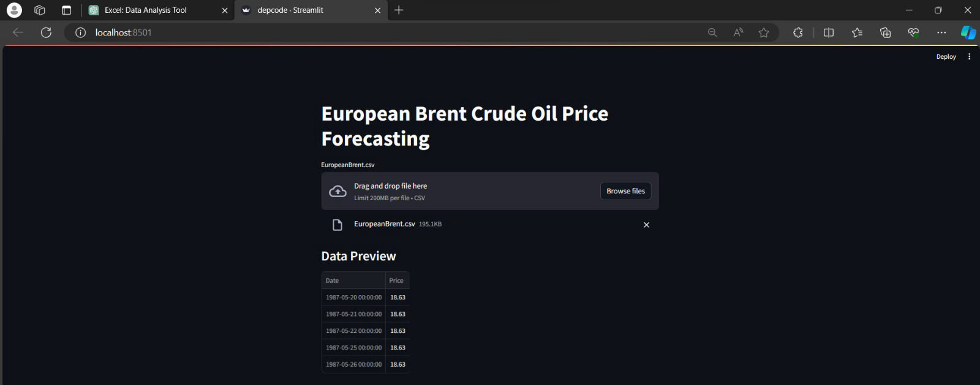
Model Deployment

Slide 29
Challenges Faced During Project Work
In Sarima model it’s difficult to do the deployment as it takes a long time execute.
It’s also challenging to see the streamlit package, where it is stored in our system.
Creating the web page (parameters needs to be clear to display the output properly).
Streamlit location is important in creating a webpage.

Slide 30
Conclusion and Key Findings
- Key insights from the reveal a significant correlation between oil prices and economic indicators, impacting market trends and investment decisions.
- Practical implications include informing policymakers on the economic stability of oil-dependent countries, guiding investors in strategic decision-making, and aiding energy companies in risk management strategies.
- Future research directions could focus on exploring the impact of geopolitical events on oil prices, analyzing the sustainability of renewable energy sources as an alternative, and enhancing forecasting models for more accurate predictions.

